Slide 1
PI2 Validation Exercise
Final Event
Rome, 15 November 2017

Slide 2
Goal
The Partially Integrated Exercise 2 contains a coordinated attack in one country.
© Gamma. All rights reserved

Slide 3

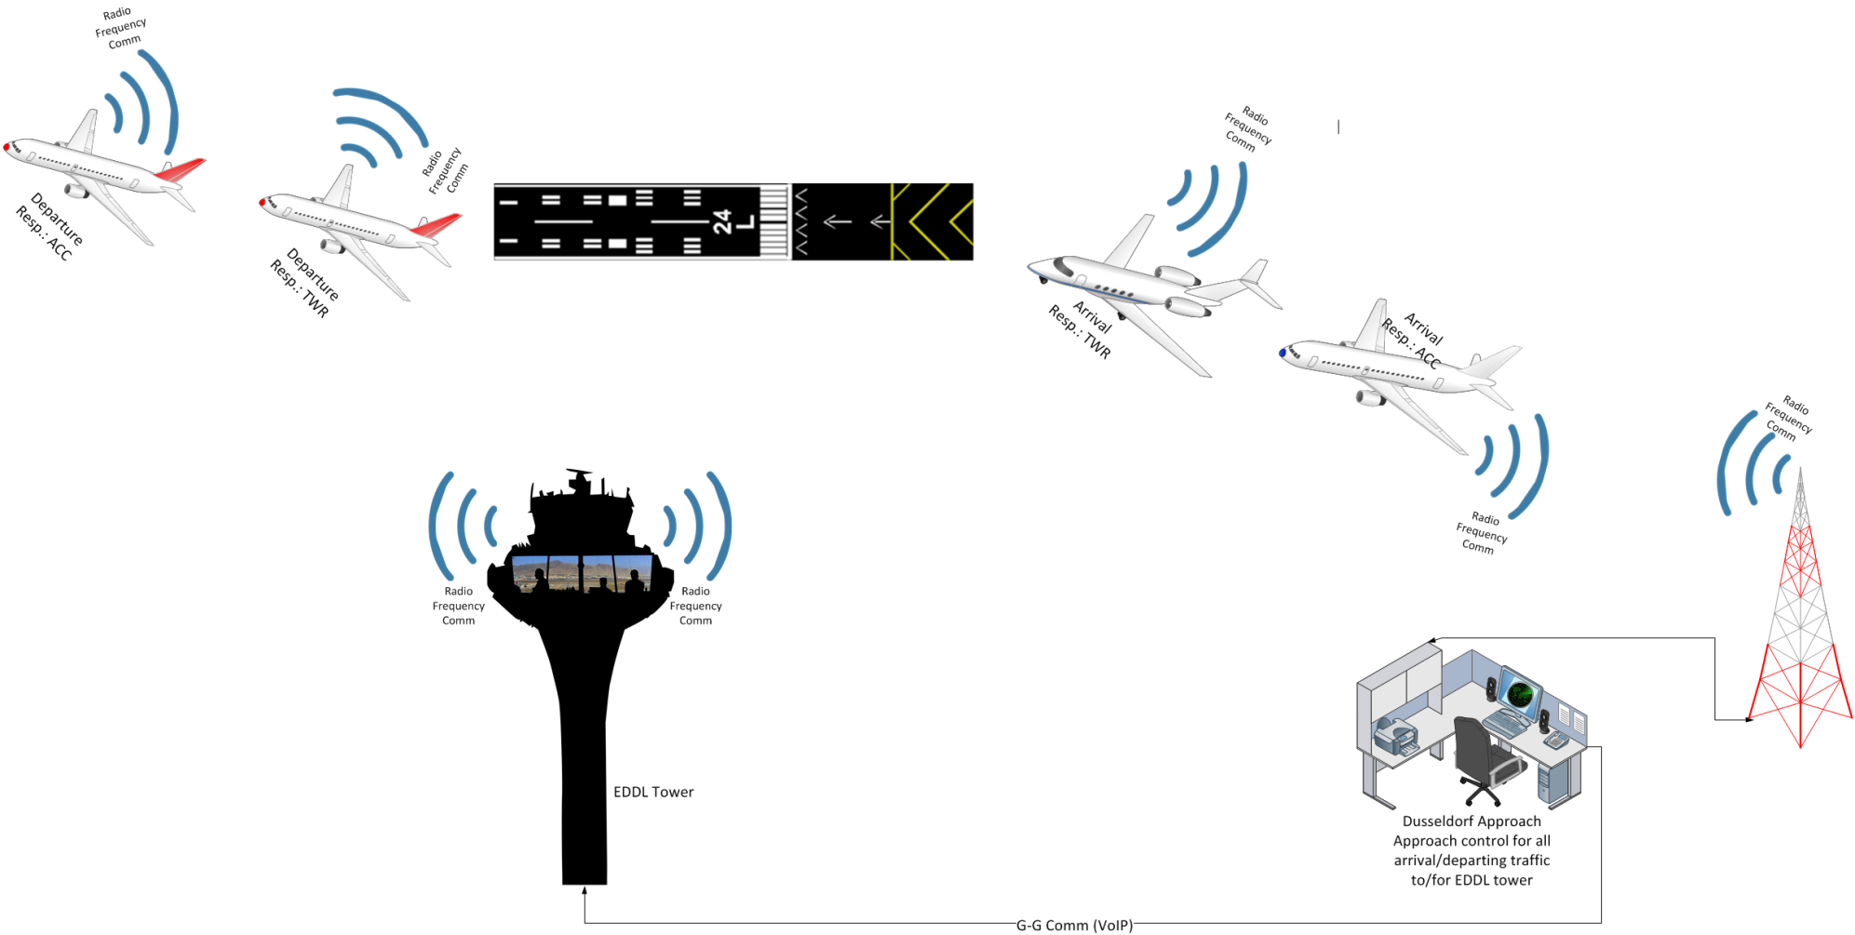




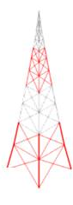

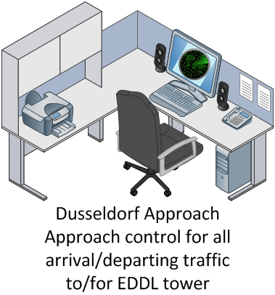
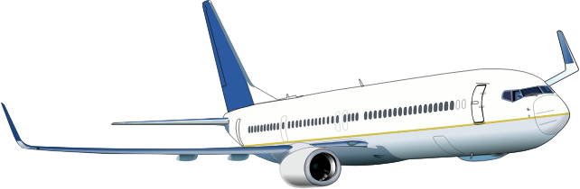
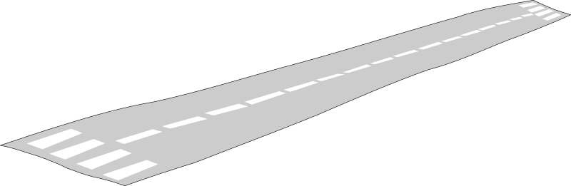
Storyline
Climb
Datalink via AEROMACS
Denial of Service Attack
Voice R/T comm
Notes:
We have an apporach center with some montains nearby, and a neighbouring Airport.
We have as well arriving flights as departure.
Communicatin on the airport with TWR is done via AEROMACS and comm with center via voice.
…..

Slide 4
Involved Prototypes
Datalink via AEROMACS
Secured by ISS
Voice R/T comm
Secured by SACom

Slide 5
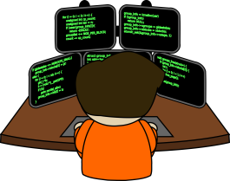
Involved Prototypes
Datalink via AEROMACS
Secured by ISS
Voice R/T comm
Secured by SACom
NGSMP

Slide 6


Locations
Exercise Lead
SACom prototype
4 ATCOs
(ROMATSA)
Braunschweig (Germany)
ISS prototype
Florence
(Italy)
SMP prototype
Chieti
(Italy)
2 Test Persons
(Leonardo)

Slide 7
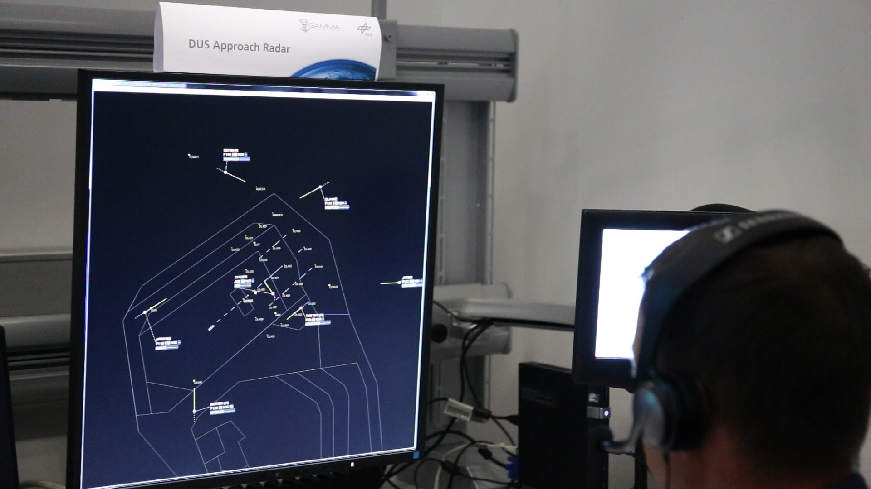
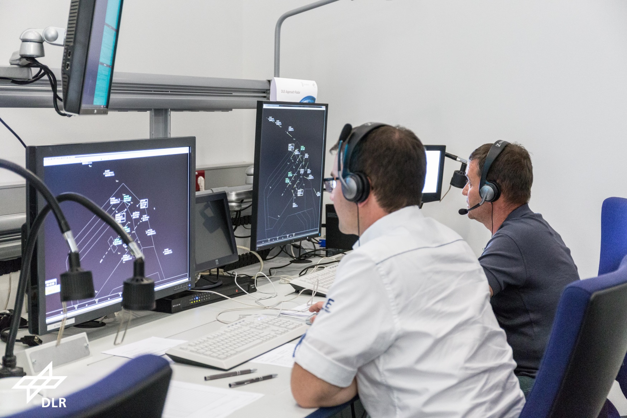
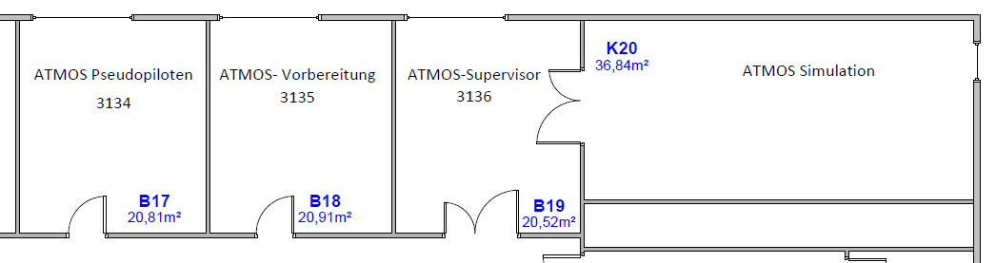



A Glance Into the Validation Execution
ATCO Working Position
Briefing
Tech / SACom
CWP2
CWP3
CWP4
CWP5
3
2
1
Supervisor
6
5
4
Pseudo
Pilots
CWPs
Sim
© Gamma. All rights reserved
ATMOS Facility DLR Braunschweig
Notes:
Animiert
Video: MVI_5121_ATCO.MOV

Slide 8
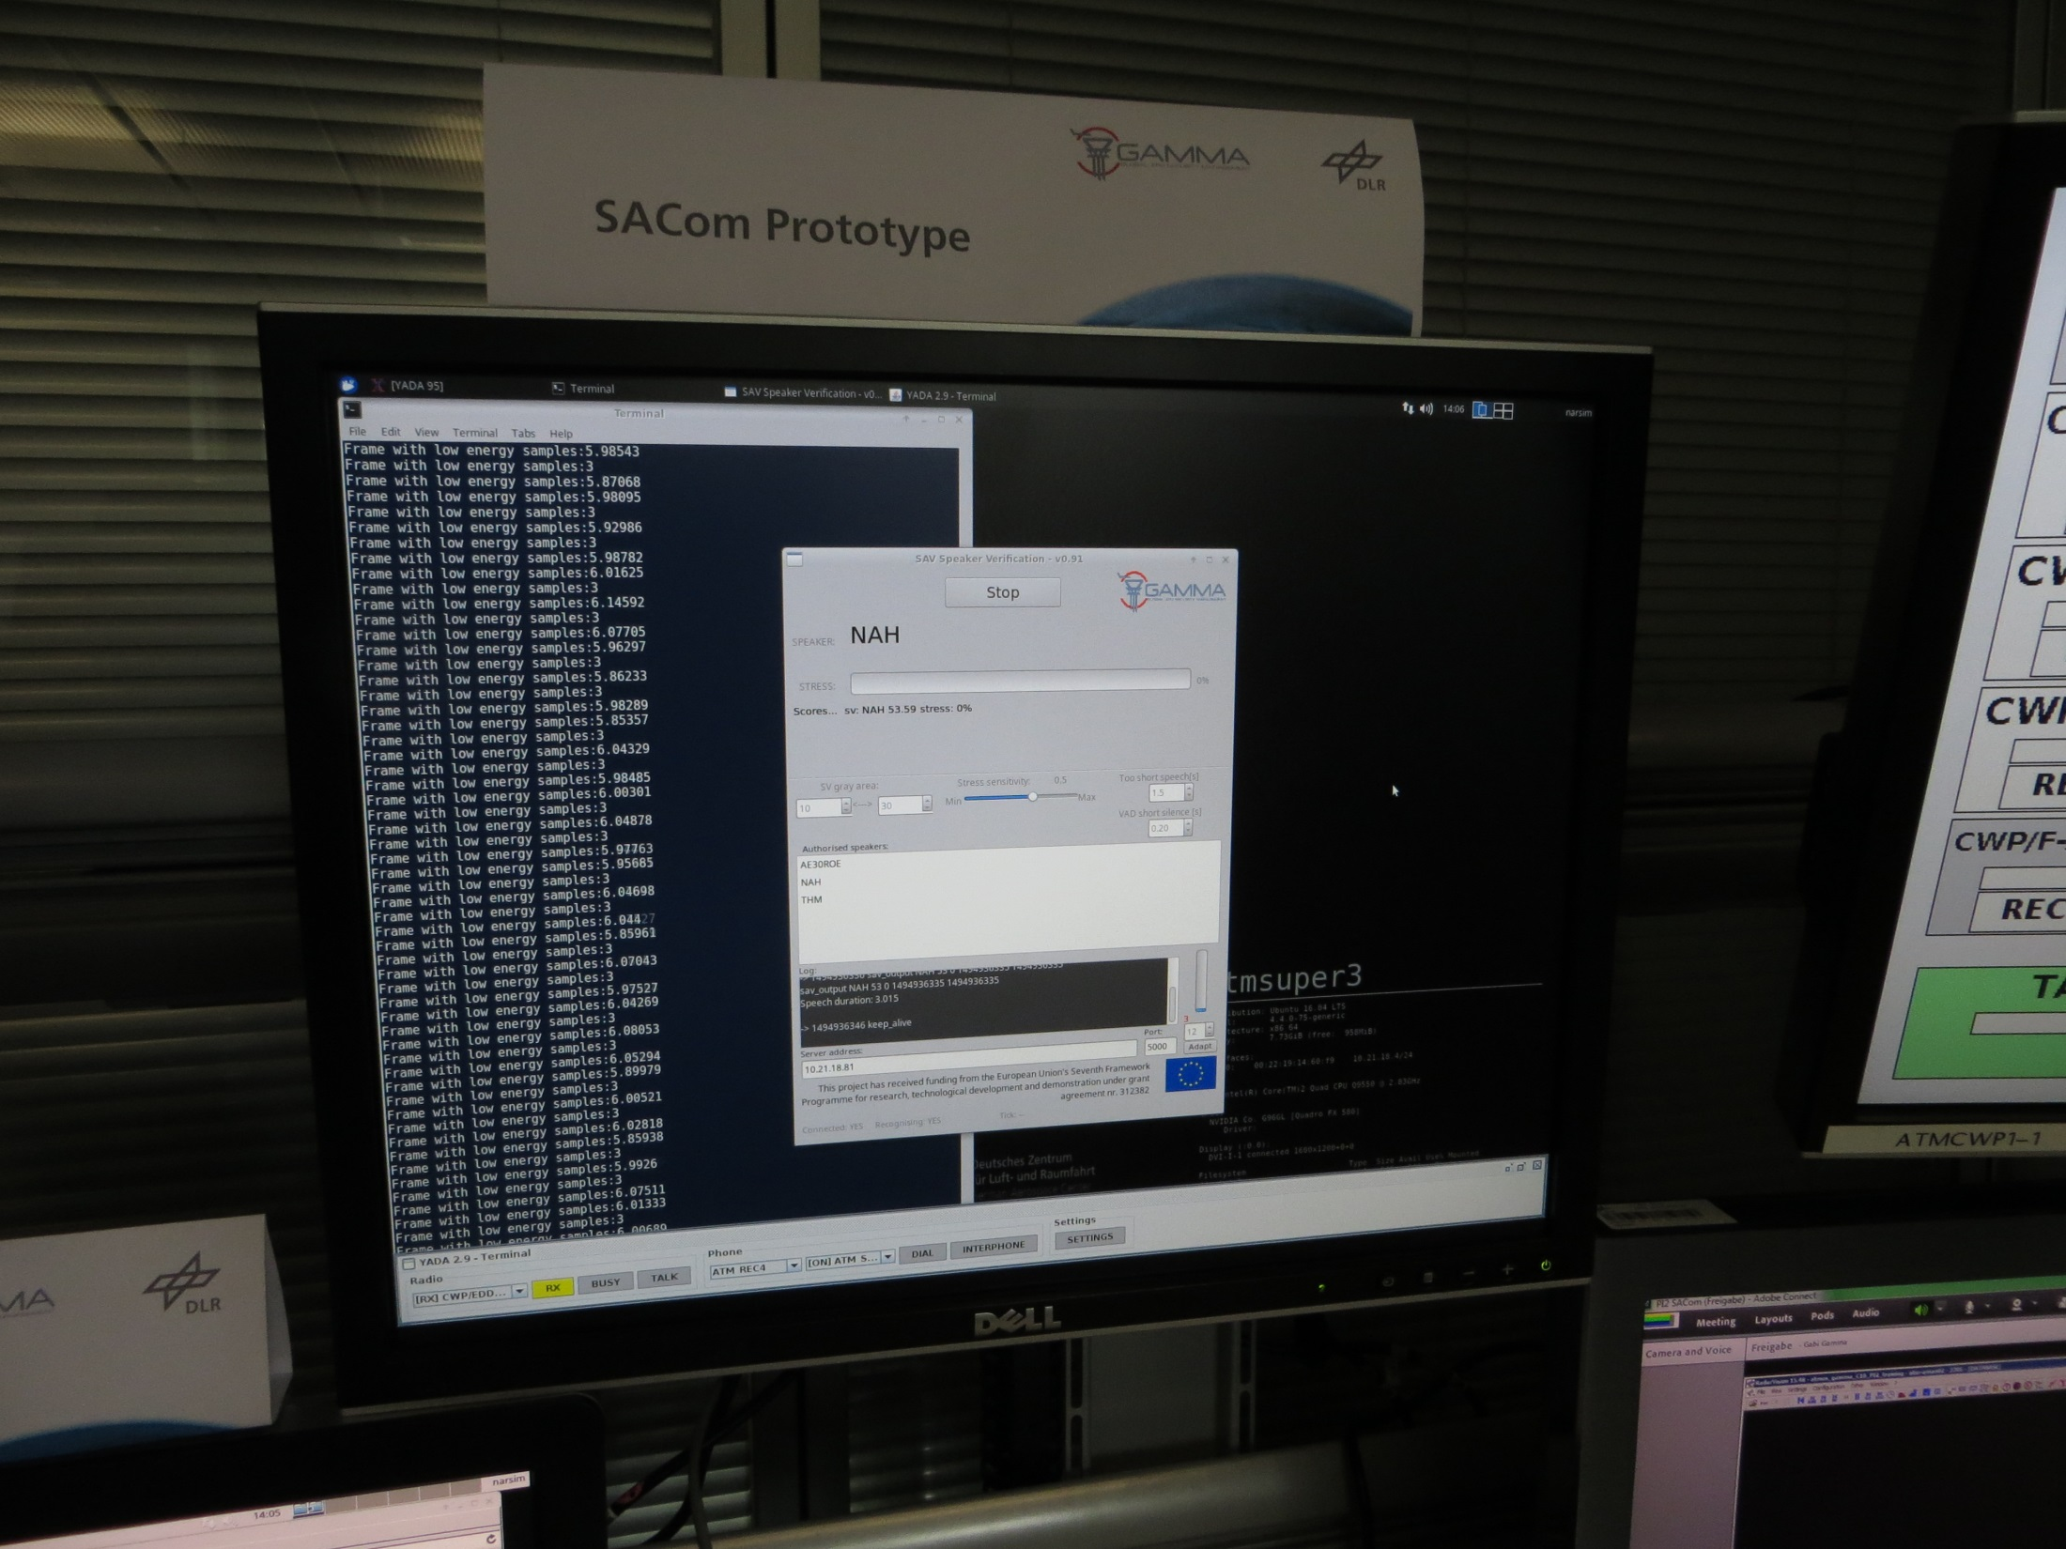
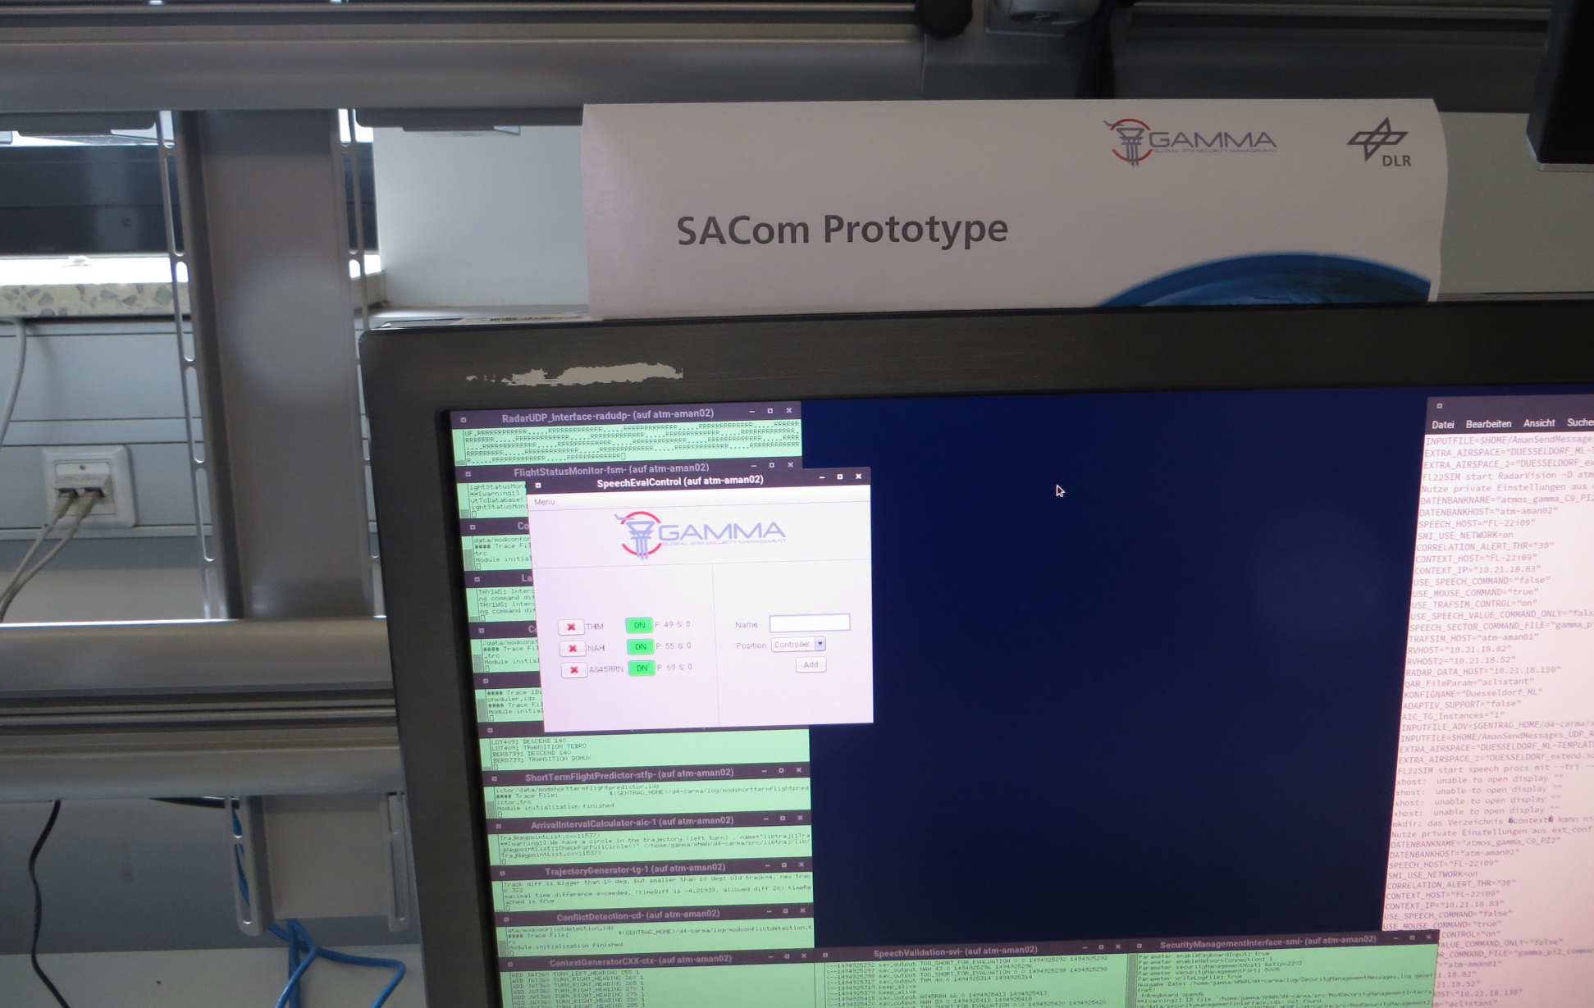
A Glance Into the Validation Execution
SACom Indications
Briefing
Tech / SACom
CWP2
CWP3
CWP4
CWP5
3
2
1
Supervisor
6
5
4
Pseudo
Pilots
CWPs
Sim
© Gamma. All rights reserved
ATMOS Facility DLR Braunschweig
Notes:
animiert

Slide 9
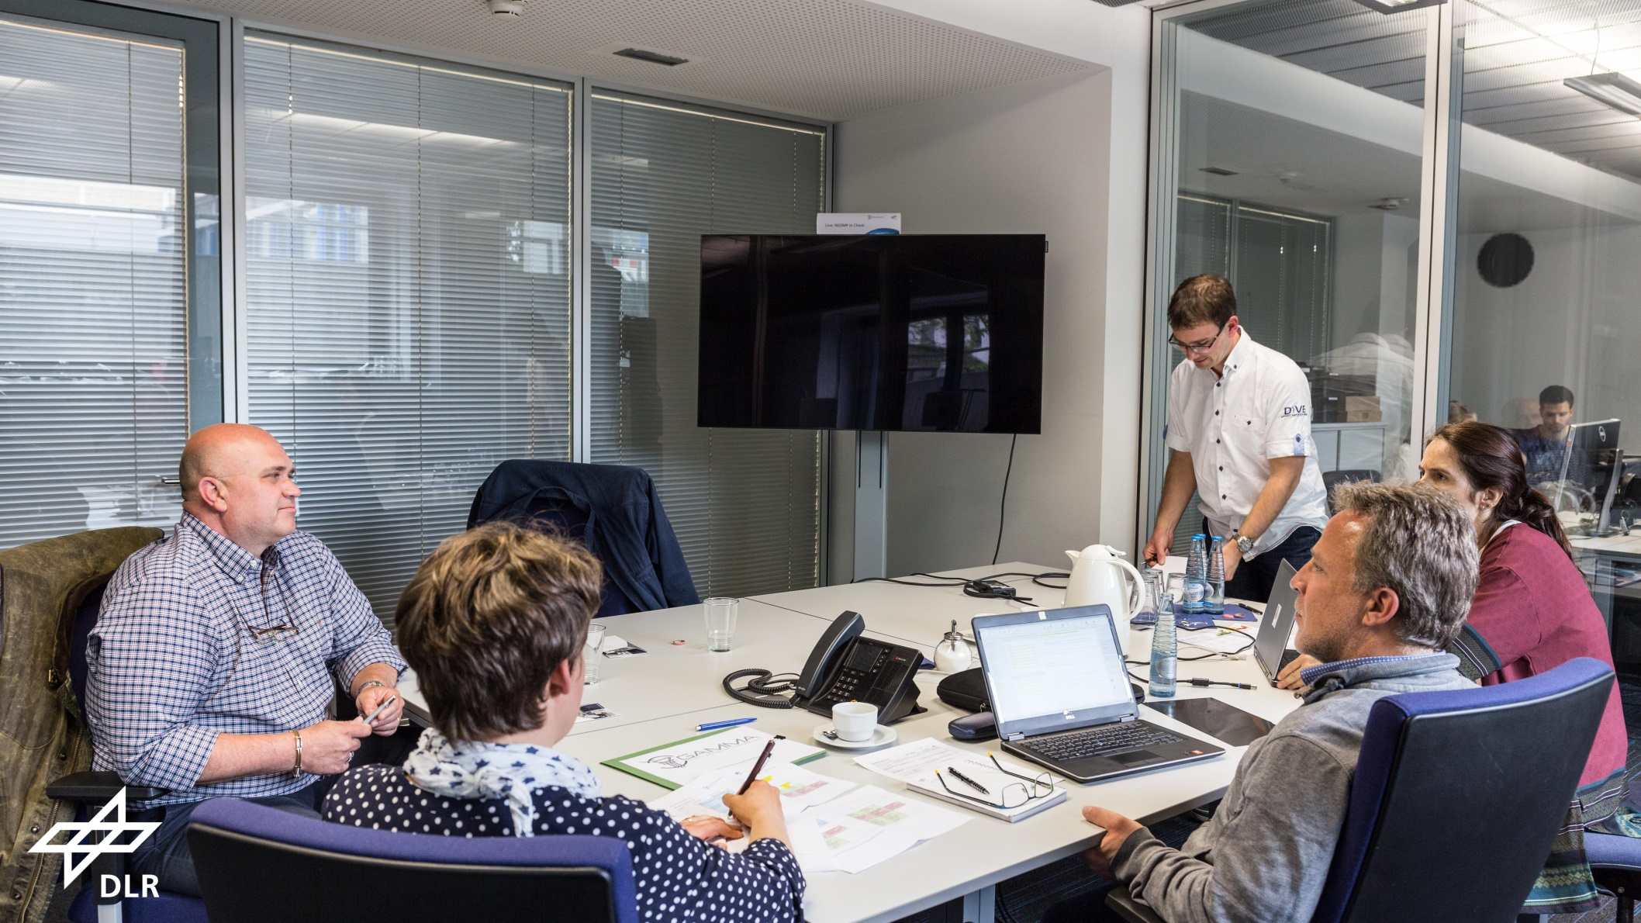
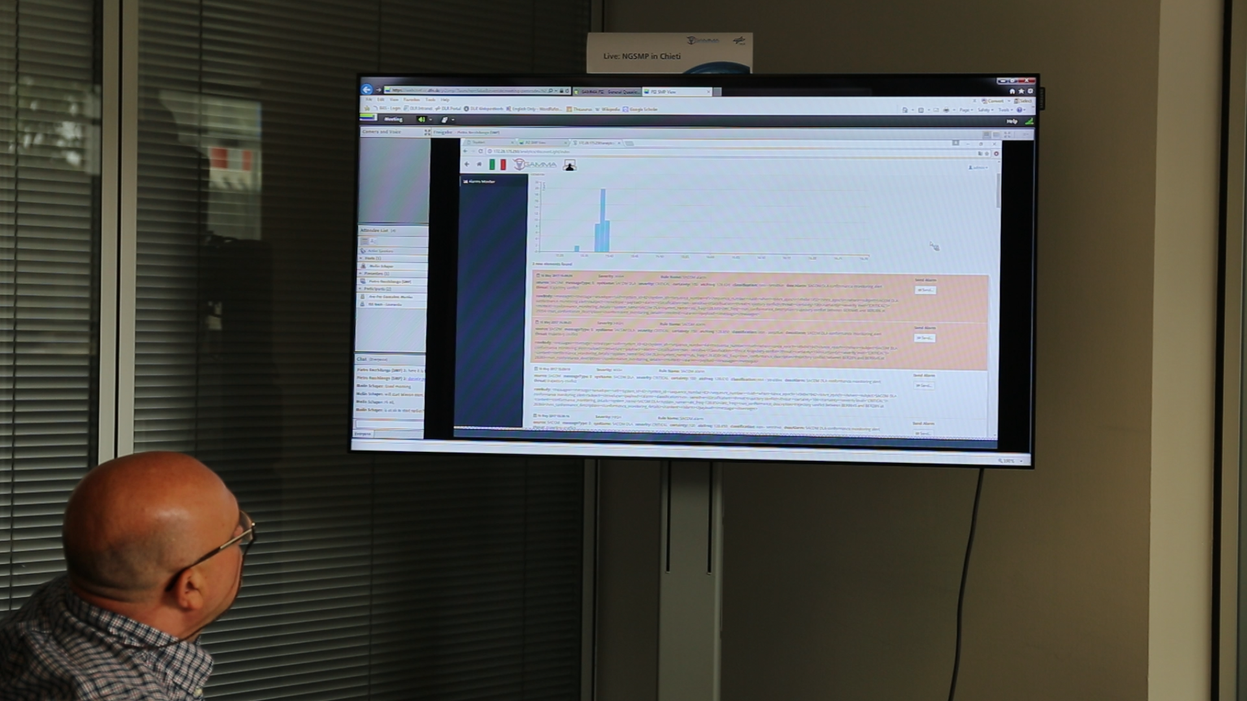
A Glance Into the Validation Execution
Briefing / De-Briefing / SMP Observation
Briefing
Tech / SACom
CWP2
CWP3
CWP4
CWP5
3
2
1
Supervisor
6
5
4
Pseudo
Pilots
CWPs
Sim
© Gamma. All rights reserved
ATMOS Facility DLR Braunschweig
Notes:
Animiert
Video: MVI_5135_SMPLiveObserver.MOV

Slide 10
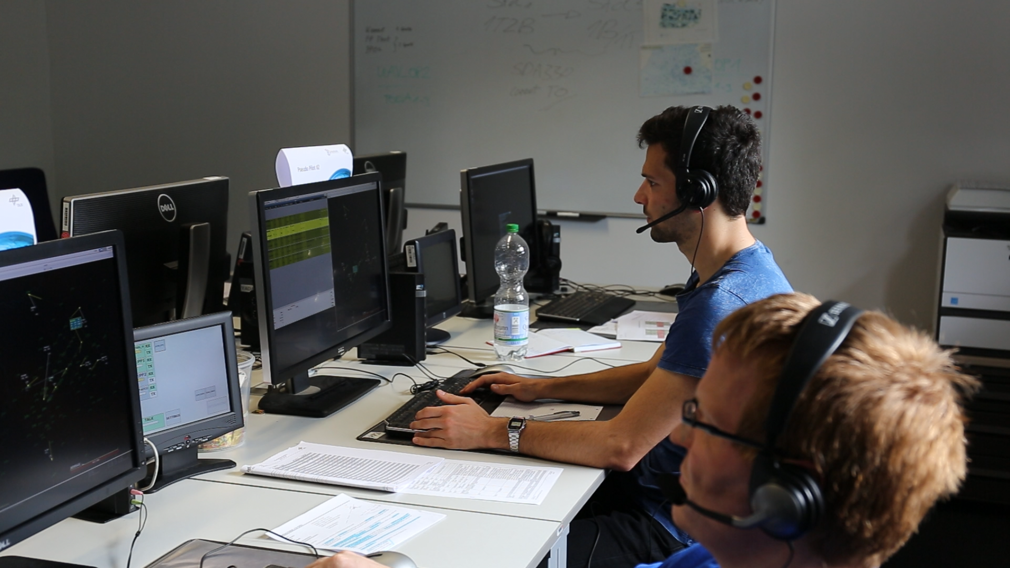
A Glance Into the Validation Execution
Pseudo Pilots
Briefing
Tech / SACom
CWP2
CWP3
CWP4
CWP5
3
2
1
Supervisor
6
5
4
Pseudo
Pilots
CWPs
Sim
© Gamma. All rights reserved
ATMOS Facility DLR Braunschweig
Notes:
Animiert
Video: MVI_5139_falseATCO.MOV

Slide 11
A Glance Into the Validation Execution
Simulation Supervisor and Exercise Lead Working Position
Briefing
Tech / SACom
CWP2
CWP3
CWP4
CWP5
3
2
1
Supervisor
6
5
4
Pseudo
Pilots
CWPs
Sim
© Gamma. All rights reserved
ATMOS Facility DLR Braunschweig
Notes:
Sequenziell auf Folien

Slide 12
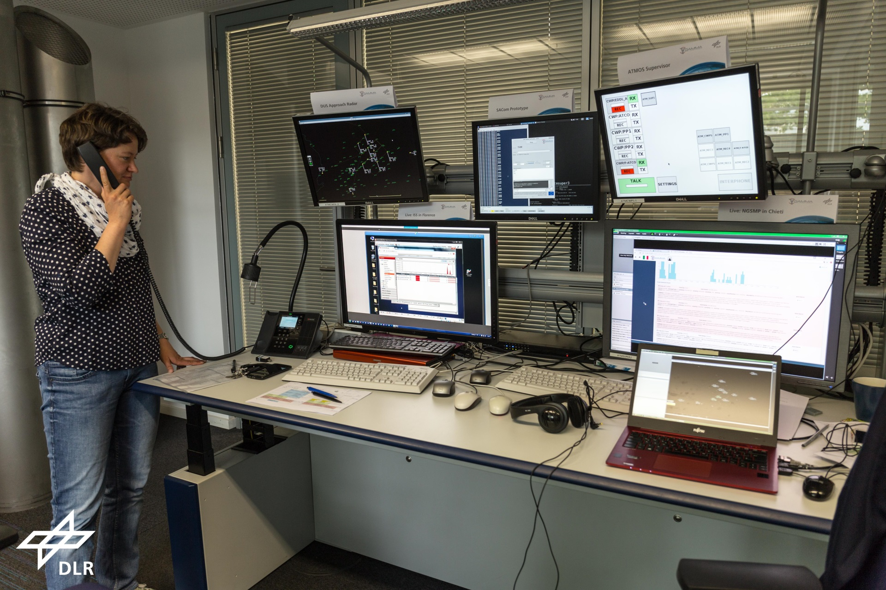
A Glance Into the Validation Execution
Simulation Supervisor and Exercise Lead Working Position
Briefing
Tech / SACom
CWP2
CWP3
CWP4
CWP5
3
2
1
Supervisor
6
5
4
Pseudo
Pilots
CWPs
Sim
© Gamma. All rights reserved
ATMOS Facility DLR Braunschweig
Notes:
Alles animiert

Slide 13
A Glance Into the Validation Execution
Simulation Supervisor and Exercise Lead Working Position
Briefing
Tech / SACom
CWP2
CWP3
CWP4
CWP5
3
2
1
Supervisor
6
5
4
Pseudo
Pilots
CWPs
Sim
© Gamma. All rights reserved
ATMOS Facility DLR Braunschweig
ISS
(live picture)
Notes:
Alles animiert

Slide 14
A Glance Into the Validation Execution
Simulation Supervisor and Exercise Lead Working Position
Briefing
Tech / SACom
CWP2
CWP3
CWP4
CWP5
3
2
1
Supervisor
6
5
4
Pseudo
Pilots
CWPs
Sim
© Gamma. All rights reserved
ATMOS Facility DLR Braunschweig
SACom
Notes:
Alles animiert

Slide 15
A Glance Into the Validation Execution
SACom Detail
Simulation Supervisor and Exercise Lead Working Position (SACom Detail)
SACom

Slide 16
A Glance Into the Validation Execution
Simulation Supervisor and Exercise Lead Working Position
Briefing
Tech / SACom
CWP2
CWP3
CWP4
CWP5
3
2
1
Supervisor
6
5
4
Pseudo
Pilots
CWPs
Sim
© Gamma. All rights reserved
ATMOS Facility DLR Braunschweig
NGSMP
(live picture)
Notes:
Alles animiert

Slide 17
A Glance Into the Validation Execution
Simulation Supervisor and Exercise Lead Working Position
Briefing
Tech / SACom
CWP2
CWP3
CWP4
CWP5
3
2
1
Supervisor
6
5
4
Pseudo
Pilots
CWPs
Sim
© Gamma. All rights reserved
ATMOS Facility DLR Braunschweig
DUS
Radar
Notes:
Alles animiert

Slide 18
A Glance Into the Validation Execution
Simulation Supervisor and Exercise Lead Working Position
Briefing
Tech / SACom
CWP2
CWP3
CWP4
CWP5
3
2
1
Supervisor
6
5
4
Pseudo
Pilots
CWPs
Sim
© Gamma. All rights reserved
ATMOS Facility DLR Braunschweig
Coordination Teleconference
Notes:
Alles animiert

Slide 19
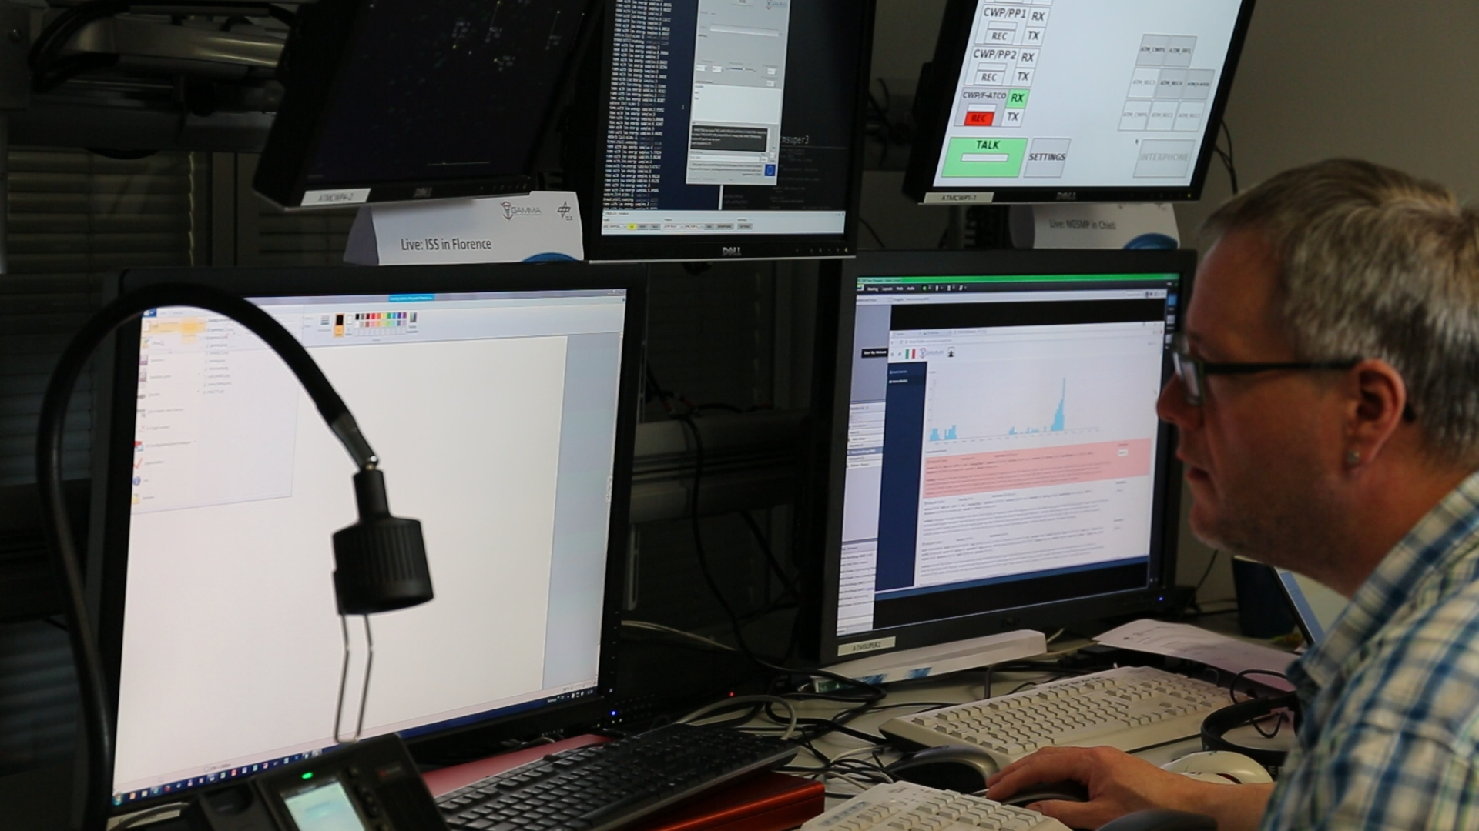
A Glance Into the Validation Execution
Simulation Supervisor and Exercise Lead Working Position
Briefing
Tech / SACom
CWP2
CWP3
CWP4
CWP5
3
2
1
Supervisor
6
5
4
Pseudo
Pilots
CWPs
Sim
© Gamma. All rights reserved
ATMOS Facility DLR Braunschweig
Notes:
Video: MVI_5053_SUP+Msg.MOV : no specific situation

Slide 20
Getting Results
Getting Results…
© Gamma. All rights reserved

Slide 21
Getting Results
We did four runs…
 | Run | SMP operator | ATCo | Exercise Observer
 | Final_test | HF expert | Internal
Day 1 | PI2_1 | SMP_op#1 | ATCo#1
 | PI2_2 | SMP_op#1 | ATCo#2 | ATCo#1
Day 2 | PI2_3 | SMP_op#2 | ATCo#3
 | PI2_4b | SMP_op#2 | ATCo#4 | ATCo#3
Notes:
… we had four runs
… jetzt folge ein Schnelldurchlauf, nicht um Details zu sehen, sondern den Prozess.

Slide 22
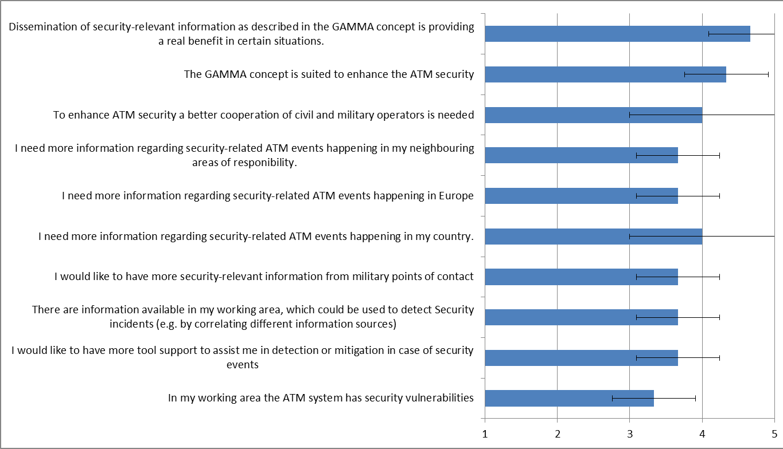
Getting Results
  …evaluated questionnaires….

Slide 23
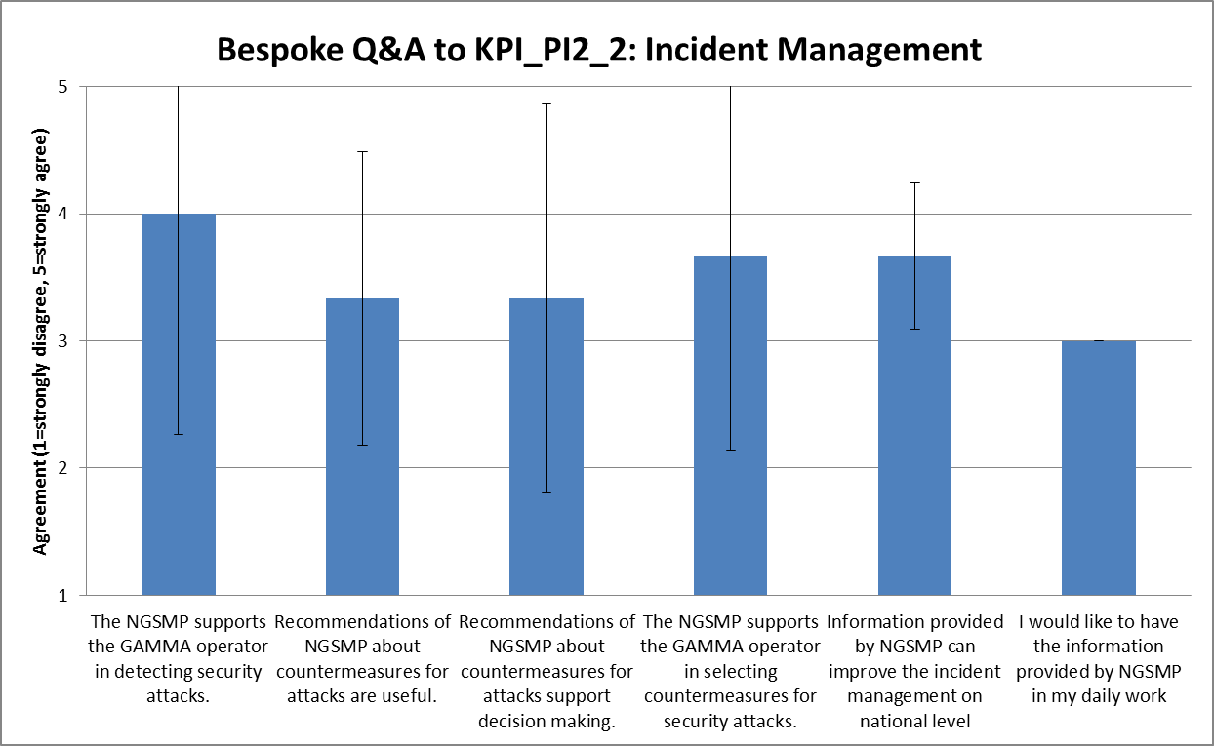
Getting Results
…sorted them according KPI, Acceptance Criteria…

Slide 24
Getting Results
… and Objectives.
© Gamma. All rights reserved

Slide 25
Results
Obj.-9_1: To validate that NGSMP is able to correlate attacks to different targets.
Obj.-9_2: To validate that the information provided by NGSMP is can improve the incident management on National Level.
Obj.-9_3: To validate that the automated fusion of data originating from several local security systems on National Level is useful for the GAMMA operator and the person(s) responsible for decision making and initialing countermeasures.
Obj.-9_4: To validate the fitness for purpose of the GAMMA concept.
✓ fulfilled
✓ fulfilled
✓ fulfilled
© Gamma. All rights reserved
✓ fulfilled
Notes:
… und daraus ergibt sich schließlich dieses hier. Soll ich animieren?

Slide 26
Summary
An example of a complex, geo-distributed security validation activity with three security prototypes was described
Evidence provided that security approach taken in the project improves today’s situation
Especially certain aspects of new security approach (i.e. combining information about attacks on a higher level) highly appreciated by participants
Delivered concept of coordinated security attack management offers opportunity to
  support decision making and
  suggest recommendations about appropriate countermeasures
Improvement/research needed for:
  presentation of such complex information and
  connected issues of situation awareness, trust and usability of the technical systems
First time that geo-distributed validation environment with locations all over Europe was used to simulate multiple security threats happening in one nation

Slide 27
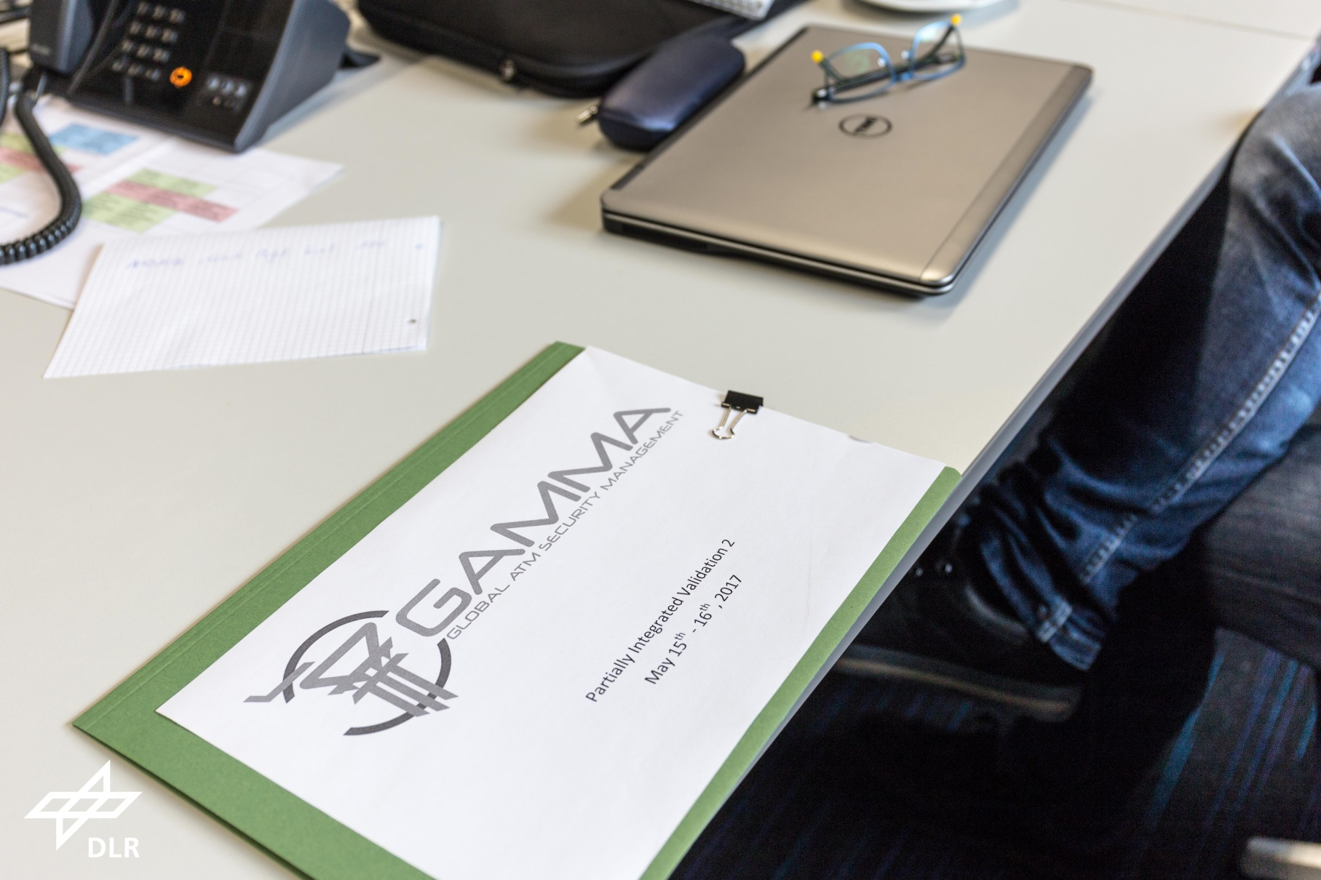
Questions?
© Gamma. All rights reserved

Slide 28
Questions?
© Gamma. All rights reserved

